Slide 1
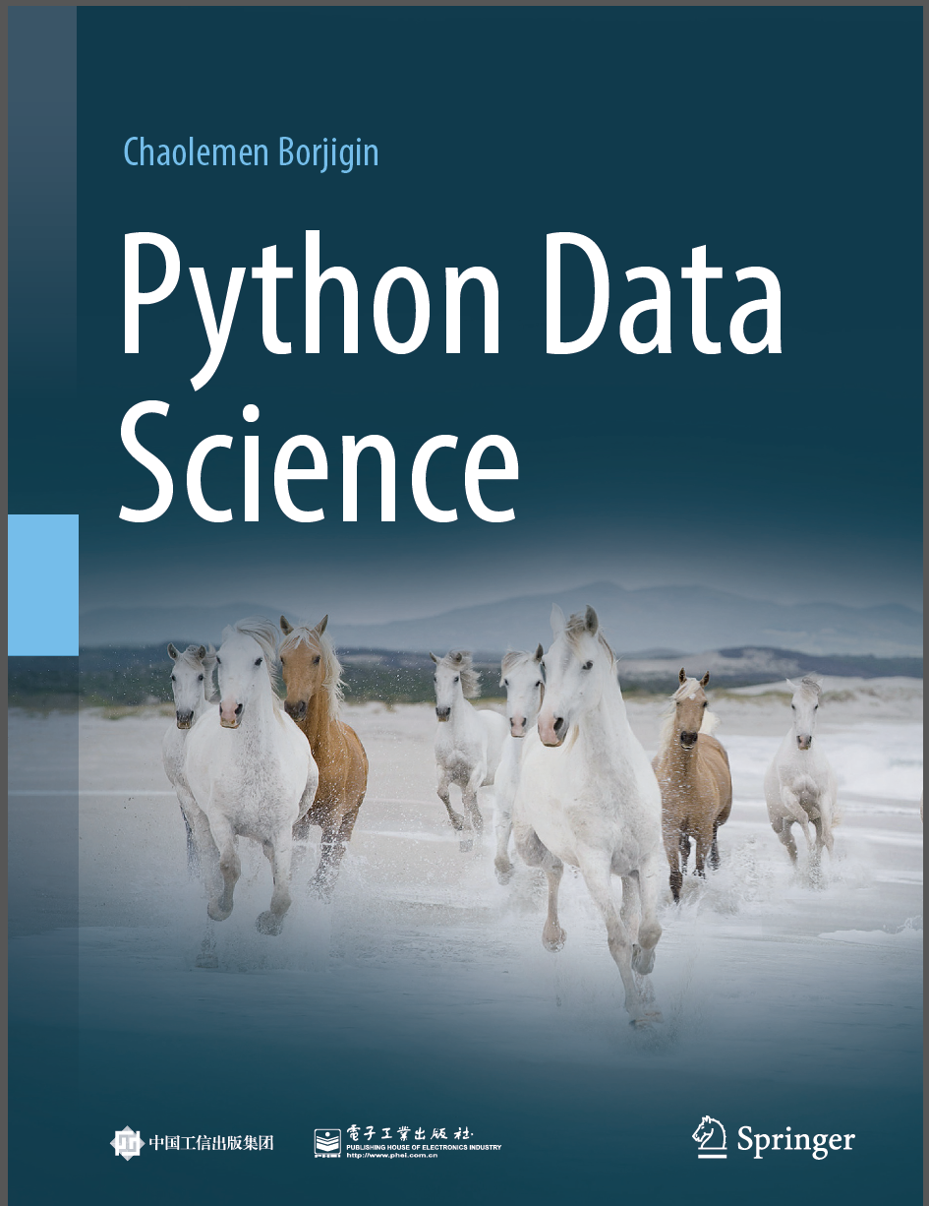
Python Programming —— From Data Analysis to Data Science
Chaolemen Borjigin
Renmin University of China
chaolemen@ruc.edu.cn

Slide 2
5.3 Natural language understanding with NLTK
Chaolemen Borjigin
Renmin University of China
chaolemen@ruc.edu.cn

Slide 3
Summary of this chapter
▼Chapter 5 Data analysis with Python
► 5.3 Natural language understanding with NLTK
5.3.3 Data understanding
5.3.4 Text normalization
5.3.5 Tokenization
5.3.6 Extracting high frequency words
5.3.7 Generating word clouds
5.3.2 Data loading
5.3.1 Business understanding

Slide 4
5.3.1 Business understanding
▼Chapter 5 Data analysis with Python
► 5.3 Natural language understanding with NLTK
Natural Language Tool Kit (NLTK) and spaCy are two of the most popular English Natural Language Processing (NLP) tools available in Python.
In this chapter, we will use NLTK (Natural Language Toolkit) to analyze the inaugural speeches of the US presidents from 1789 to 2017 and compare the frst speeches of four presidents: Clinton, Bush, Obama, and Trump. The data consists of multiple inaugural speeches collected from the inaugural corpus of NLTK.

Slide 5
5.3.2 Data loading
▼Chapter 5 Data analysis with Python
► 5.3 Natural language understanding with NLTK
import jieba
import jieba.posseg as pseg
import numpy as np
import pandas as pd
Import re
import matplotlib as mpl
import matplotlib.pyplot as plt
%matplotlib inline
from wordcloud import WordCloud
import nltk
In[1]:

Slide 6
5.3.2 Data loading
▼Chapter 5 Data analysis with Python
► 5.3 Natural language understanding with NLTK
from nltk.corpus import inaugural
print(inaugural.fleids())
In[2]:
Out[2]:
'['1789-Washington.txt', '1793-Washington.txt', '1797-Adams.txt', '1801-Jefferson.
txt', '1805-Jefferson.txt', '1809-Madison.txt', '1813-Madison.txt', '1817-Monroe.
txt', '1821-Monroe.txt', '1825-Adams.txt', '1829-Jackson.txt', '1833-Jackson.
txt', '1837-VanBuren.txt', '1841-Harrison.txt', '1845-Polk.txt', '1849-Taylor.
txt', '1853-Pierce.txt', '1857-Buchanan.txt', '1861-Lincoln.txt', '1865-Lincoln.
txt', '1869-Grant.txt', '1873-Grant.txt', '1877-Hayes.txt', '1881-Garfeld.txt',
'1885-Cleveland.txt', '1889-Harrison.txt', '1893-Cleveland.txt', '1897-McKinley.
txt', '1901-McKinley.txt', '1905-Roosevelt.txt', '1909-Taft.txt', '1913-Wilson.
txt', '1917-Wilson.txt', '1921-Harding.txt', '1925-Coolidge.txt', '1929-Hoover.txt',
'1933-Roosevelt.txt', '1937-Roosevelt.txt', '1941-Roosevelt.txt', '1945-Roosevelt.txt',
'1949-Truman.txt', '1953-Eisenhower.txt', '1957-Eisenhower.txt', '1961-Kennedy.txt',
'1965-Johnson.txt', '1969-Nixon.txt', '1973-Nixon.txt', '1977-Carter.txt', '1981-Reagan.
txt', '1985-Reagan.txt', '1989-Bush.txt', '1993-Clinton.txt', '1997-Clinton.txt', '2001-
Bush.txt', '2005-Bush.txt', '2009-Obama.txt', '2013-Obama.txt', '2017-Trump.txt']

Slide 7
5.3.2 Data loading
▼Chapter 5 Data analysis with Python
► 5.3 Natural language understanding with NLTK
len(inaugural.fleids())
In[3]:
58
Out[3]:

Slide 8
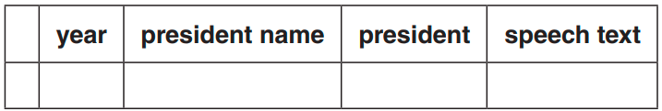
5.3.3 Data understanding
▼Chapter 5 Data analysis with Python
► 5.3 Natural language understanding with NLTK
cols = ['year','president name','president', 'speech text']
#to create an empty DataFrame with the column names
df_inaugural = pd.DataFrame(columns=cols)
df_inaugural
In[4]:
Out[4]:

Slide 9
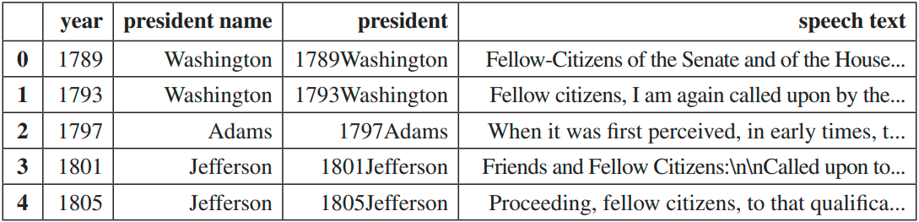
5.3.3 Data understanding
▼Chapter 5 Data analysis with Python
► 5.3 Natural language understanding with NLTK
In[5]:
for i in inaugural.fleids():
year = i[0:4]
name = re.fndall(r'\-(.*)\.',i)[0]
president = year+name
text = inaugural.raw(i)
df_inaugural = df_inaugural.append({'year':year,'president
name':name,'president':president,'speech text':text}, ignore_index=True)
df_inaugural.head()
Out[5]:

Slide 10
5.3.3 Data understanding
▼Chapter 5 Data analysis with Python
► 5.3 Natural language understanding with NLTK
In[6]:
df_inaugural['"America" count'] = df_inaugural['speech text'].apply(lambda x:
x.count('America'))
df_inaugural['"we" count'] = df_inaugural['speech text'].apply(lambda x: x.count('we'
or 'We'))
df_inaugural['"you" count'] = df_inaugural['speech text'].apply(lambda x: x.count('you'
or 'You'))
df_inaugural.head()

Slide 11
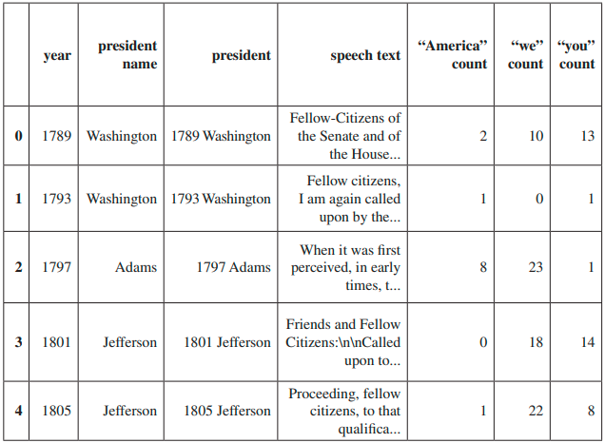
5.3.3 Data understanding
▼Chapter 5 Data analysis with Python
► 5.3 Natural language understanding with NLTK
Out[6]:

Slide 12
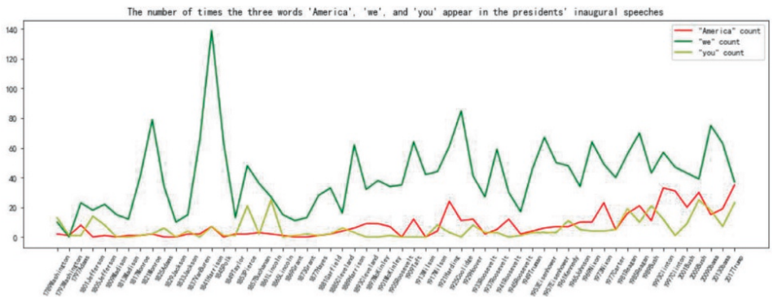
5.3.3 Data understanding
▼Chapter 5 Data analysis with Python
► 5.3 Natural language understanding with NLTK
In[7]:
fig = plt.figure(fgsize=(16,5))
plt.xticks(size = 8, rotation = 60)
plt.plot(df_inaugural['president'],df_inaugural['"America" count'],c='r',label='"America"
count')
plt.plot(df_inaugural['president'],df_inaugural['"we" count'],c='g',label='"we" count')
plt.plot(df_inaugural['president'],df_inaugural['"you" count'],c='y',label='"you" count')
plt.legend()
plt.title("The number of times the three words 'America', 'we', and 'you' appear in the
presidents' inaugural speeches")
plt.show()
Out[7]:

Slide 13
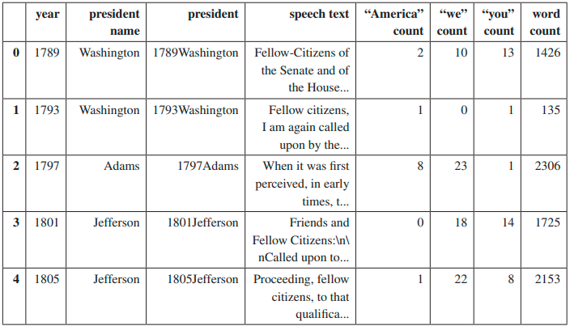
5.3.3 Data understanding
▼Chapter 5 Data analysis with Python
► 5.3 Natural language understanding with NLTK
In[8]:
df_inaugural['word count'] = df_inaugural['speech text'].apply(lambda x: len(str(x).
split(" ")))
df_inaugural.head()
Out[8]:

Slide 14
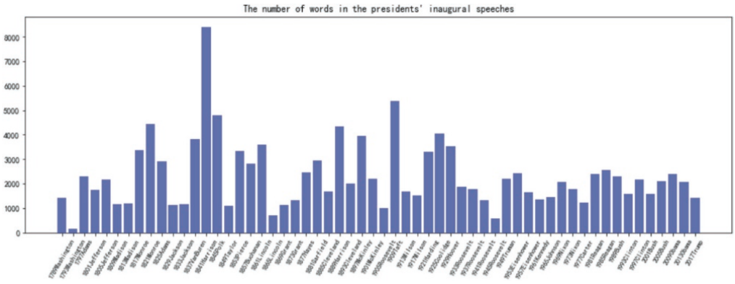
5.3.3 Data understanding
▼Chapter 5 Data analysis with Python
► 5.3 Natural language understanding with NLTK
In[9]:
fig = plt.figure(figsize=(16,5))
plt.xticks(np.arange(len(df_inaugural['president'])), df_inaugural['president'],size = 8,
rotation = 60)
plt.bar(np.arange(len(df_inaugural['word count'])),df_inaugural['word count'], color='blue',
alpha=0.5)
plt.title("The number of words in the presidents' inaugural speeches")
Out[9]:

Slide 15
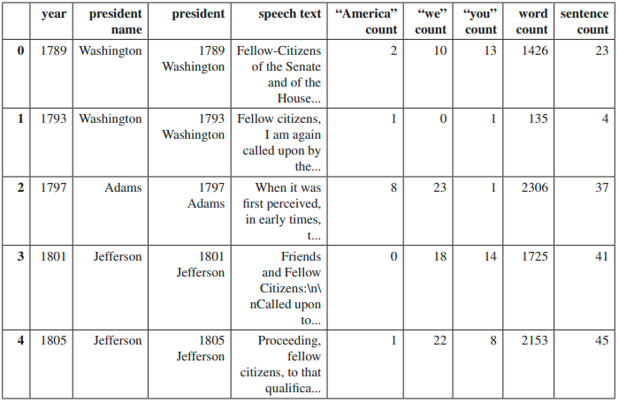
5.3.3 Data understanding
▼Chapter 5 Data analysis with Python
► 5.3 Natural language understanding with NLTK
In[10]:
from nltk.tokenize import sent_tokenize
df_inaugural['sentence count'] = df_inaugural['speech text'].apply(lambda x: len(sent_
tokenize(x)))
df_inaugural.head()
Out[10]:

Slide 16
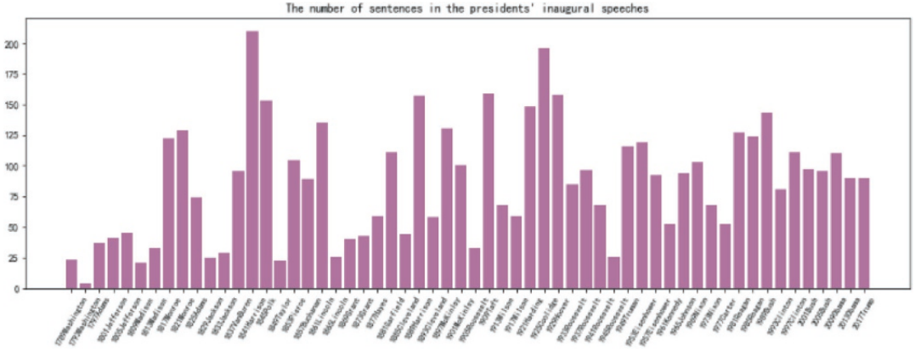
5.3.3 Data understanding
▼Chapter 5 Data analysis with Python
► 5.3 Natural language understanding with NLTK
In[11]:
fig = plt.figure(figsize=(16,5))
plt.xticks(np.arange(len(df_inaugural['president'])), df_inaugural['president'],size = 8,
rotation = 60)
plt.bar(np.arange(len(df_inaugural['sentence count'])),df_inaugural['sentence count'],
color='purple', alpha=0.5)
plt.title("The number of sentences in the presidents' inaugural speeches")
Out[11]:

Slide 17
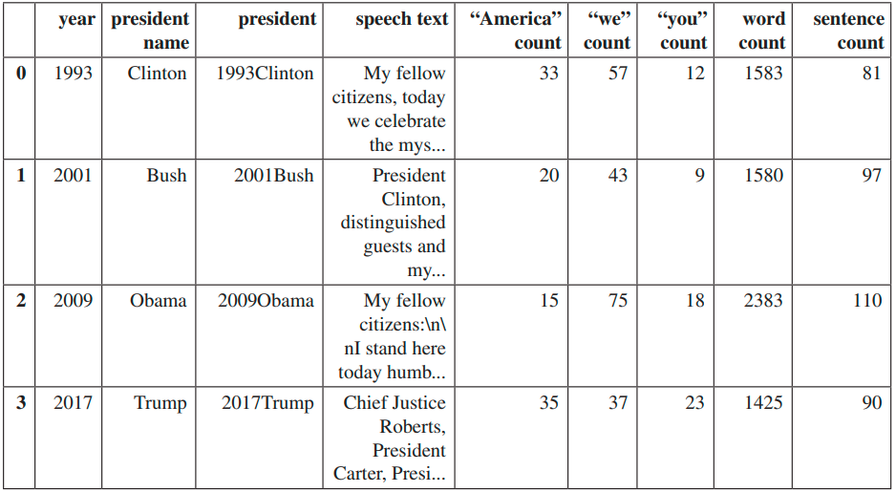
5.3.3 Data understanding
▼Chapter 5 Data analysis with Python
► 5.3 Natural language understanding with NLTK
In[12]:
president_speech = df_inaugural[df_inaugural['year'].isin(['2017','2009','2001','1993'])]
president_speech = president_speech.reset_index(drop=True)
president_speech
Out[12]:

Slide 18
5.3.4 Text normalization
▼Chapter 5 Data analysis with Python
► 5.3 Natural language understanding with NLTK
In[13]:
president_speech['speech text'] = president_speech['speech text'].apply(lambda x: " ".join(x.lower() for x in x.split()))
president_speech['speech text']
Out[13]:
0 my fellow citizens, today we celebrate the mys...
1 president clinton, distinguished guests and my...
2 my fellow citizens: i stand here today humbled...
3 chief justice roberts, president carter, presi...
Name: speech text, dtype: object

Slide 19
5.3.4 Text normalization
▼Chapter 5 Data analysis with Python
► 5.3 Natural language understanding with NLTK
In[14]:
president_speech['speech text'] = president_speech['speech text'].str.replace('[^\w\s]','')
president_speech['speech text']
Out[14]:
0 my fellow citizens today we celebrate the myst...
1 president clinton distinguished guests and my ...
2 my fellow citizens i stand here today humbled ...
3 chief justice roberts president carter preside...
Name: speech text, dtype: object

Slide 20
5.3.5 Tokenization
▼Chapter 5 Data analysis with Python
► 5.3 Natural language understanding with NLTK
In[15]:
from nltk.corpus import stopwords
stop_words = stopwords.words('english')
president_speech['speech text'] = president_speech['speech text'].apply(lambda x: " ".join(x for x in x.split() if x not in stop_words))
president_speech['speech text']
Out[15]:
0 fellow citizens today celebrate mystery americ...
1 president clinton distinguished guests fellow ...
2 fellow citizens stand today humbled task us gr...
3 chief justice roberts president carter preside...
Name: speech text, dtype: object

Slide 21
5.3.5 Tokenization
▼Chapter 5 Data analysis with Python
► 5.3 Natural language understanding with NLTK
In[16]:
add_stopwords = ['us','i','in','shall']
stop_words.extend(add_stopwords)
stop_words=set(stop_words)
president_speech['speech text'] = president_speech['speech text'].apply(lambda x: " ".
join(x for x in x.split() if x not in stop_words))
president_speech['speech text']
Out[16]:
0 fellow citizens today celebrate mystery americ...
1 president clinton distinguished guests fellow ...
2 fellow citizens stand today humbled task grate...
3 chief justice roberts president carter preside...
Name: speech text, dtype: object

Slide 22
5.3.6 Extracting high frequency words
▼Chapter 5 Data analysis with Python
► 5.3 Natural language understanding with NLTK
In[17]:
speech_1993Clinton = president_speech['speech text'][0]
freq_words_1993Clinton = pd.Series(speech_1993Clinton.split()).value_counts()[:5]
speech_2001Bush = president_speech['speech text'][1]
freq_words_2001Bush = pd.Series(speech_2001Bush.split()).value_counts()[:5]
speech_2009Obama = president_speech['speech text'][2]
freq_words_2009Obama = pd.Series(speech_2009Obama.split()).value_counts()[:5]
speech_2017Trump = president_speech['speech text'][3]
freq_words_2017Trump = pd.Series(speech_2017Trump.split()).value_counts()[:5]

Slide 23
5.3.6 Extracting high frequency words
▼Chapter 5 Data analysis with Python
► 5.3 Natural language understanding with NLTK
In[18]:
freq_words_2017Trump
Out[18]:
america 19
american 11
people 10
country 9
one 8
dtype: int64

Slide 24
5.3.6 Extracting high frequency words
▼Chapter 5 Data analysis with Python
► 5.3 Natural language understanding with NLTK
In[19]:
plt.fgure(fgsize=(16,16))
fg,ax = plt.subplots(2, 2, fgsize=(10,6))
plt.subplots_adjust(wspace=1.0, hspace=0.3)
ax[0][0].barh(freq_words_1993Clinton.index, freq_words_1993Clinton, color='red', alpha=0.3)
ax[0][0].set_title("High-frequency words in Clinton's inaugural speech in 1993")
ax[0][1].barh(freq_words_2001Bush.index, freq_words_2001Bush, color='green',
alpha=0.3)
ax[0][1].set_title("High-frequency words in Bush's inaugural speech in 2001")
ax[1][0].barh(freq_words_2009Obama.index, freq_words_2009Obama, color='yellow',
alpha=0.3)
ax[1][0].set_title("High-frequency words in Obama's inaugural speech in 2009")
ax[1][1].barh(freq_words_2017Trump.index, freq_words_2017Trump, color='teal',
alpha=0.3)
ax[1][1].set_title("High-frequency words in Trump's inaugural speech in 2017")
plt.show()

Slide 25
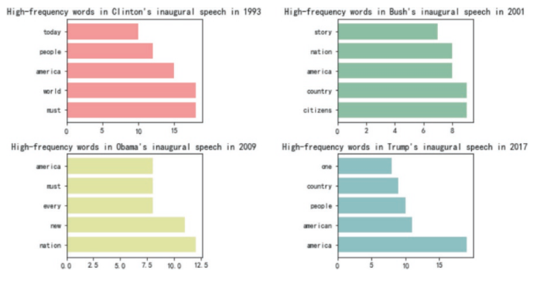
5.3.6 Extracting high frequency words
▼Chapter 5 Data analysis with Python
► 5.3 Natural language understanding with NLTK
Out[19]:

Slide 26
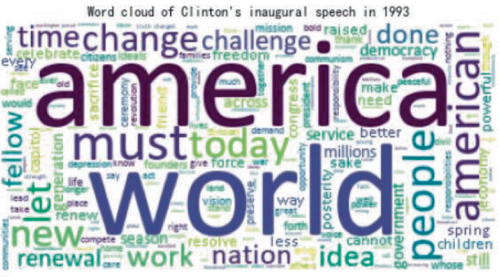
5.3.7 Generating word clouds
▼Chapter 5 Data analysis with Python
► 5.3 Natural language understanding with NLTK
In[20]:
from wordcloud import WordCloud
word_cloud = WordCloud(font_path='calibri.ttf',
background_color='white',
stopwords=stop_words)
word_cloud.generate(speech_1993Clinton)
plt.subplots(fgsize=(8,5))
plt.imshow(word_cloud)
plt.axis('off')
plt.title("Word cloud of Clinton's inaugural speech in 1993")
Out[20]:

Slide 27
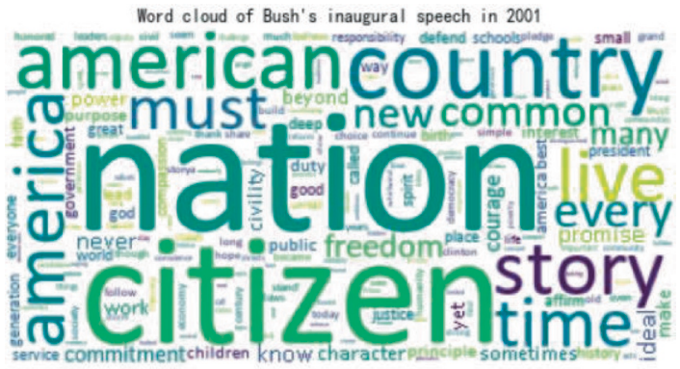
5.3.7 Generating word clouds
▼Chapter 5 Data analysis with Python
► 5.3 Natural language understanding with NLTK
In[21]:
word_cloud.generate(speech_2001Bush)
plt.subplots(fgsize=(8,5))
plt.imshow(word_cloud)
plt.axis('off')
plt.title("Word cloud of Bush's inaugural speech in 2001")
Out[21]:

Slide 28
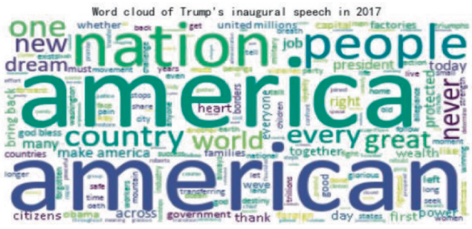
5.3.7 Generating word clouds
▼Chapter 5 Data analysis with Python
► 5.3 Natural language understanding with NLTK
In[22]:
word_cloud.generate(speech_2017Trump)
plt.subplots(fgsize=(8,5))
plt.imshow(word_cloud)
plt.axis('off')
plt.title("Word cloud of Trump's inaugural speech in 2017")
Out[22]:

Slide 29


